Slide 1
i.
ii.

Slide 2
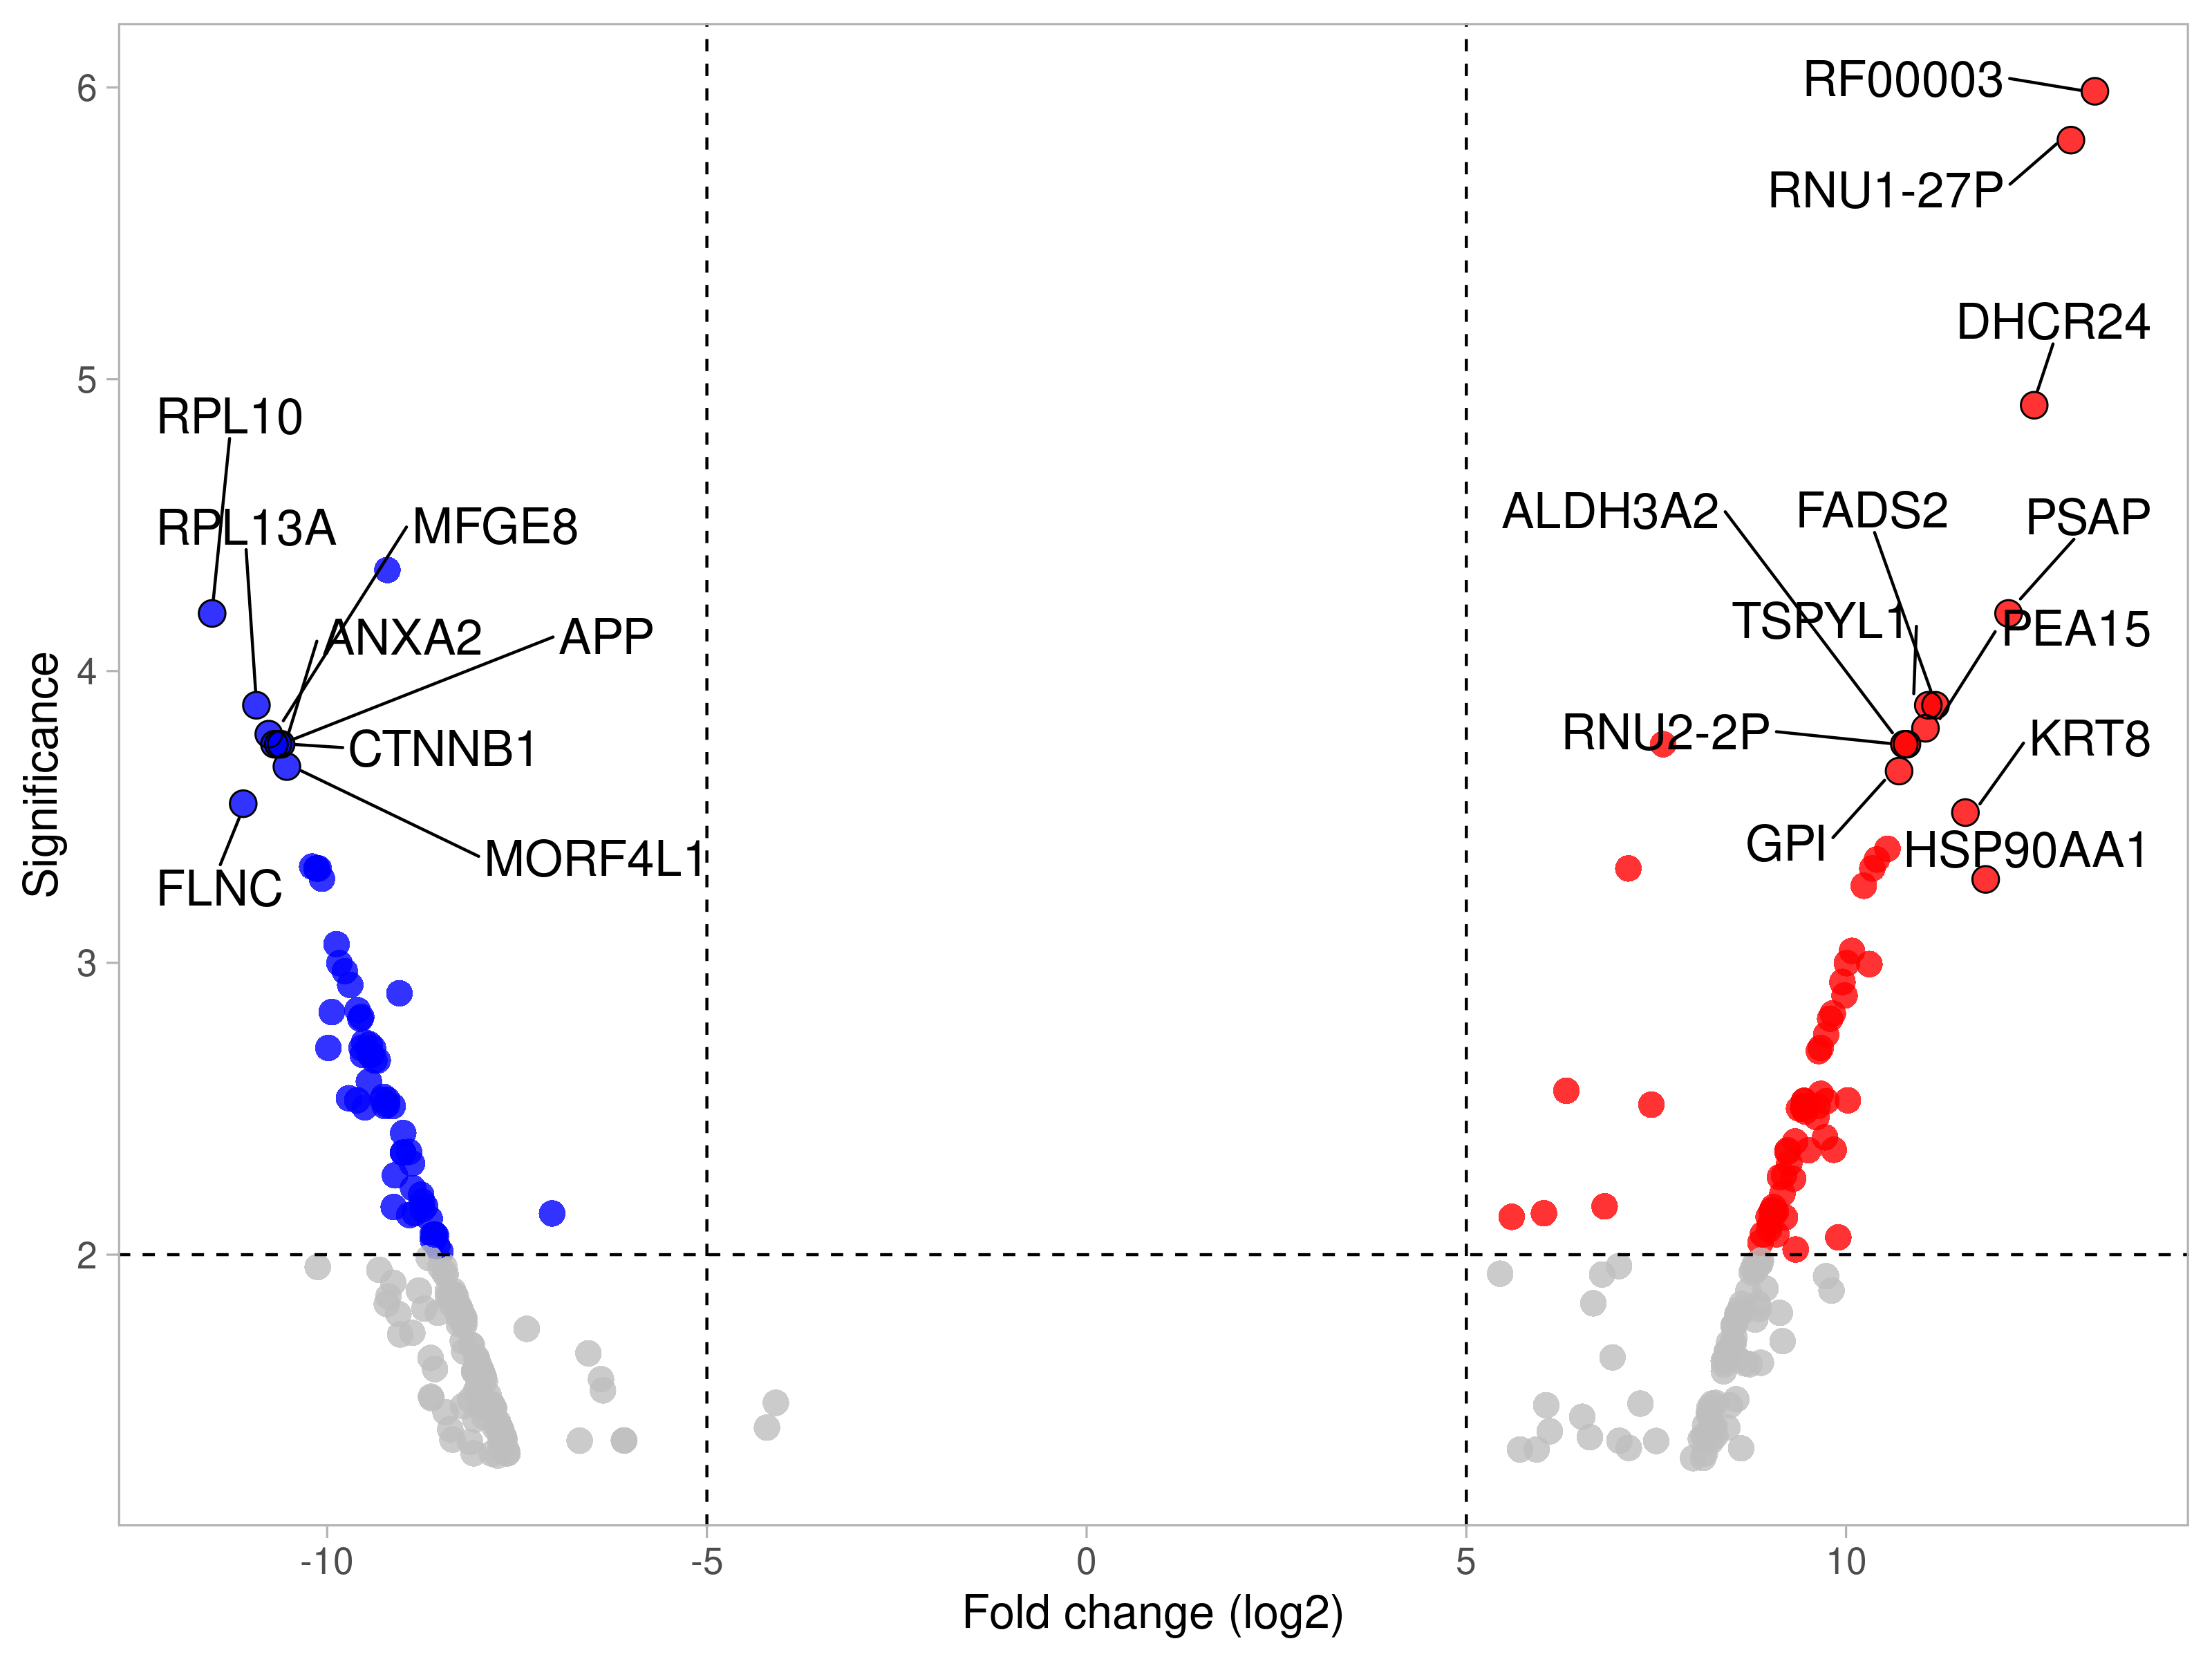
A)
B)
WT hiPSC-CMs
HCM hiPSC-CMs
-log10 p-value)
Fold change (log2)
C)
WT hiPSC-CMs
HCM hiPSC-CMs
D)
WT hiPSC-CMs
HCM hiPSC-CMs

Slide 3
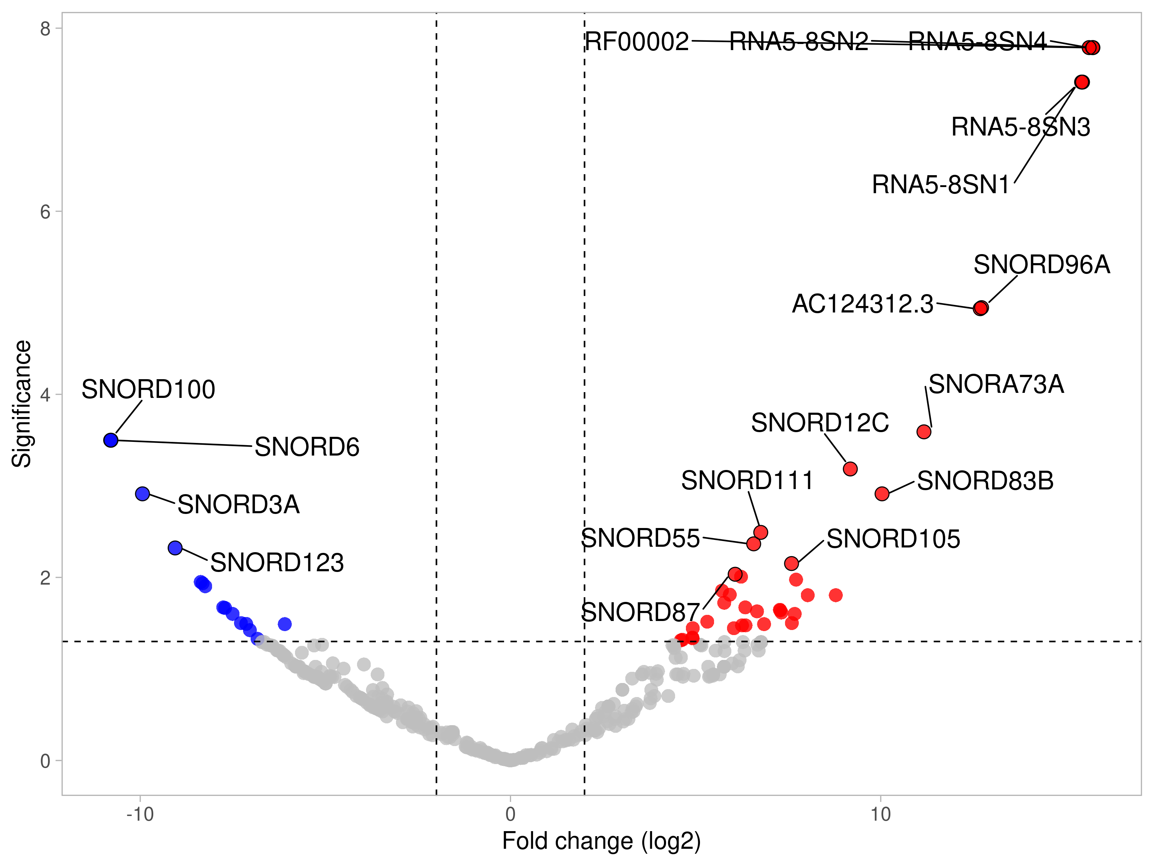
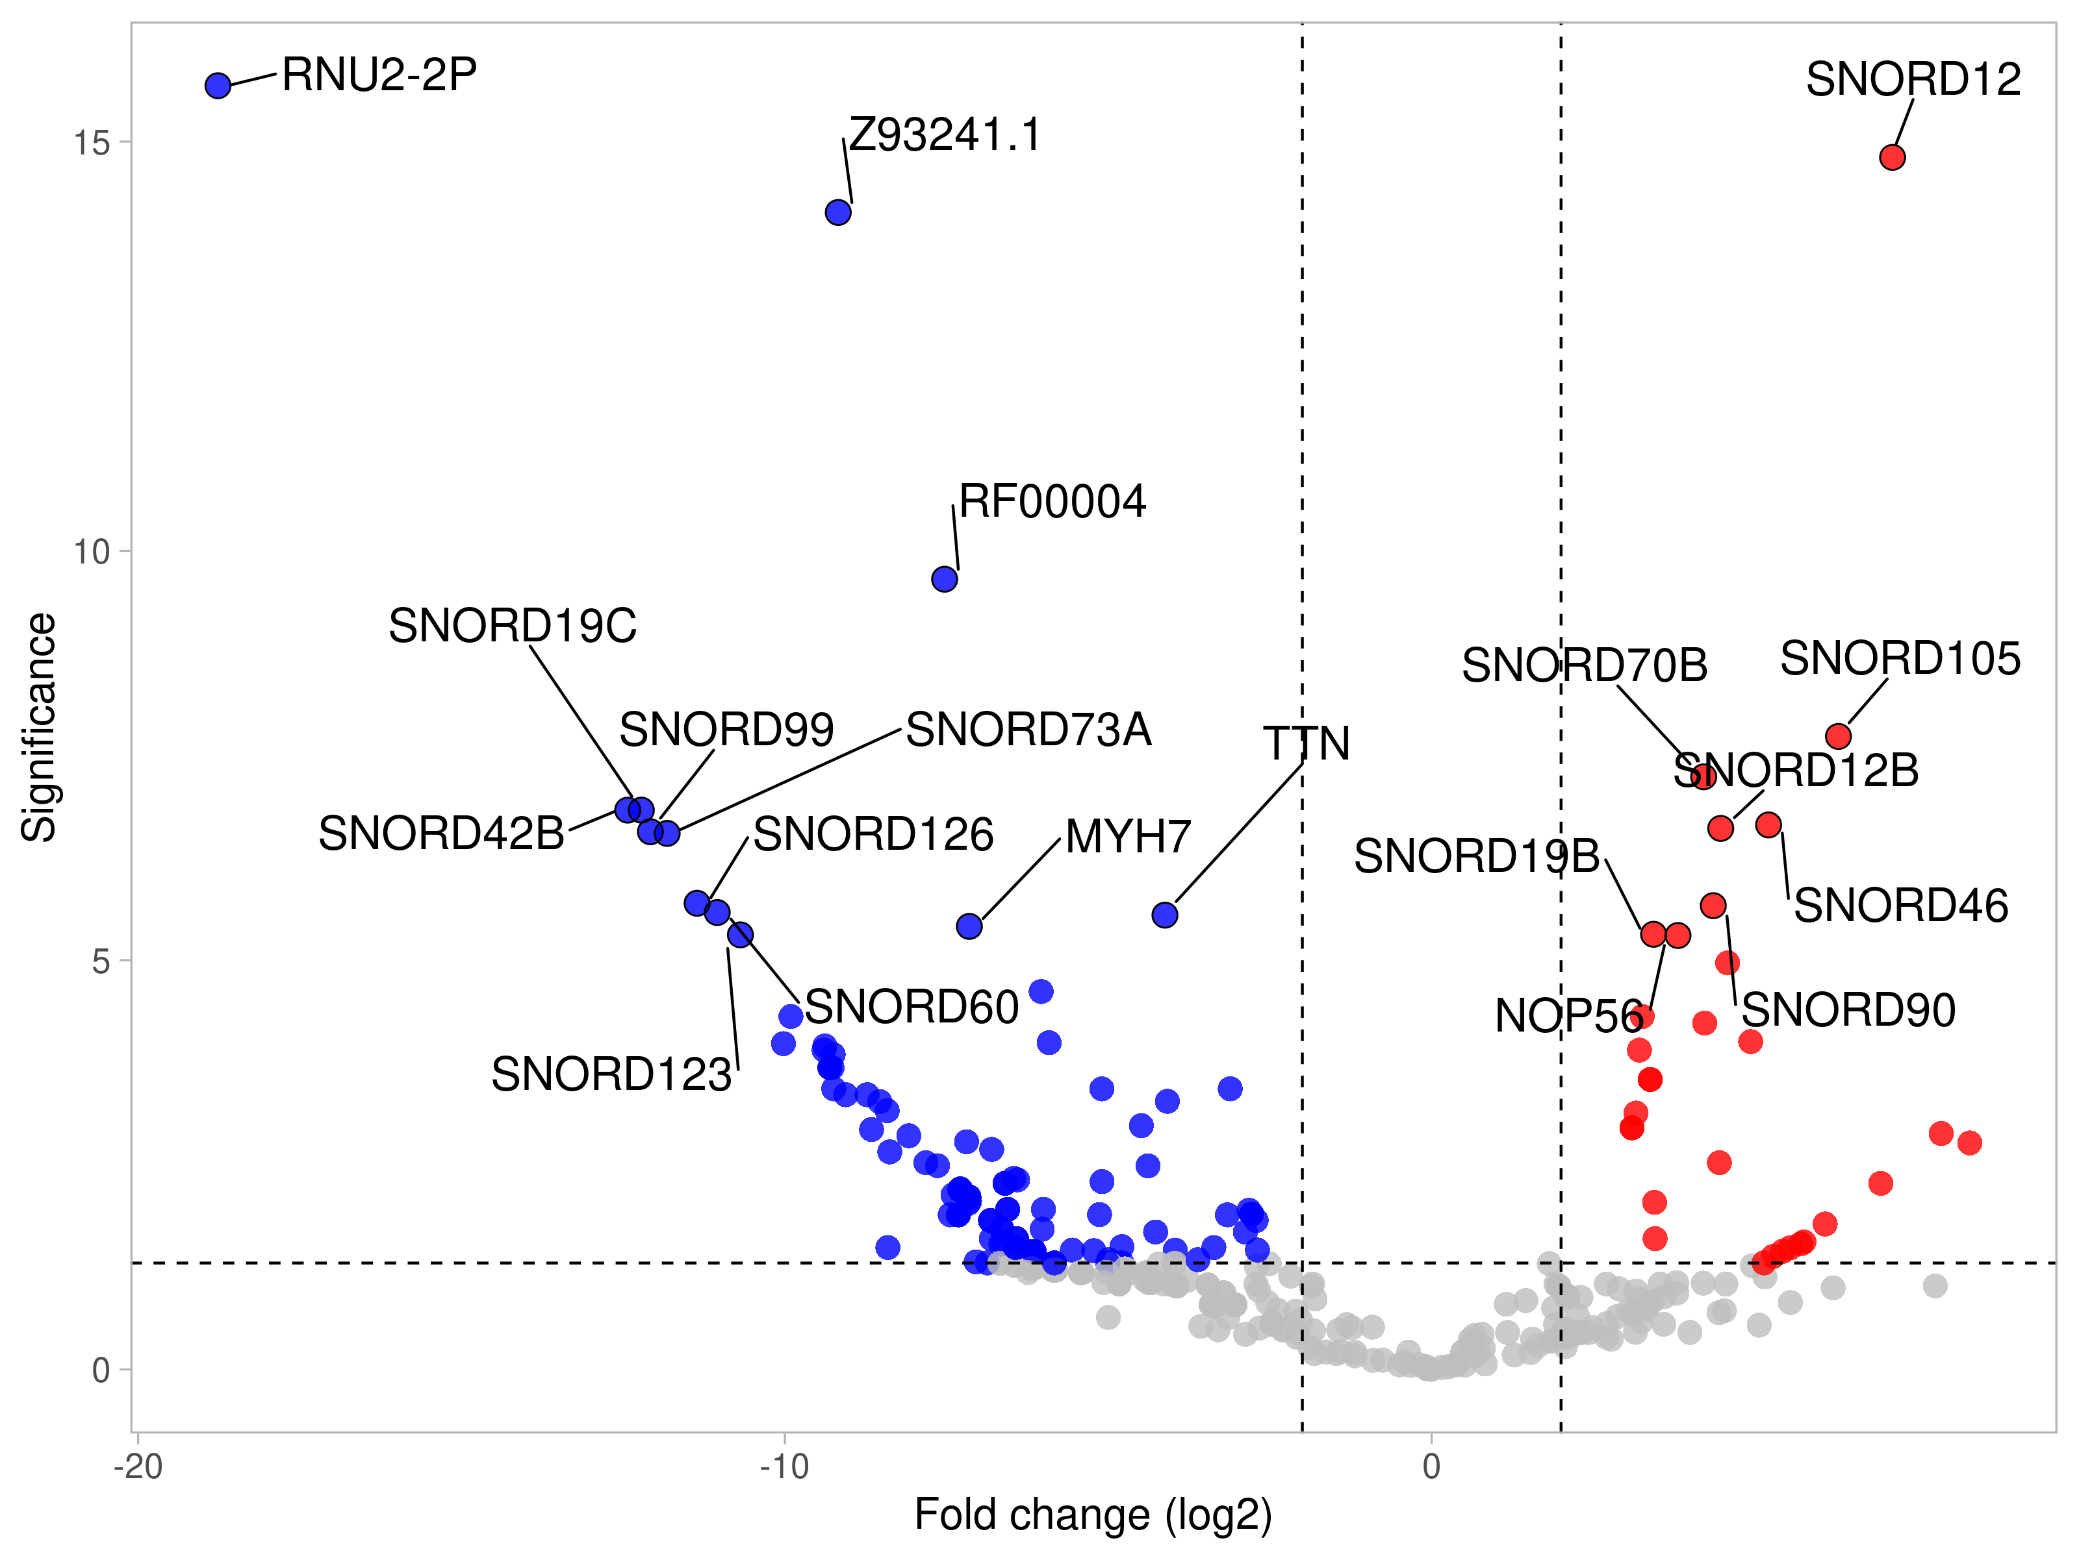
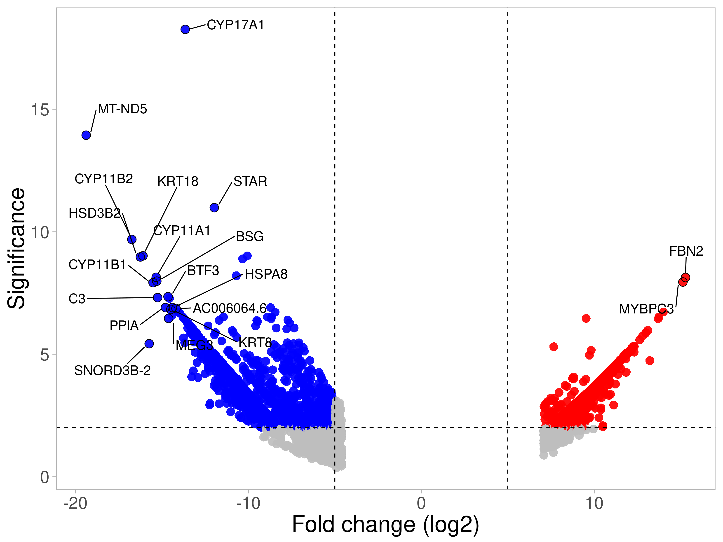
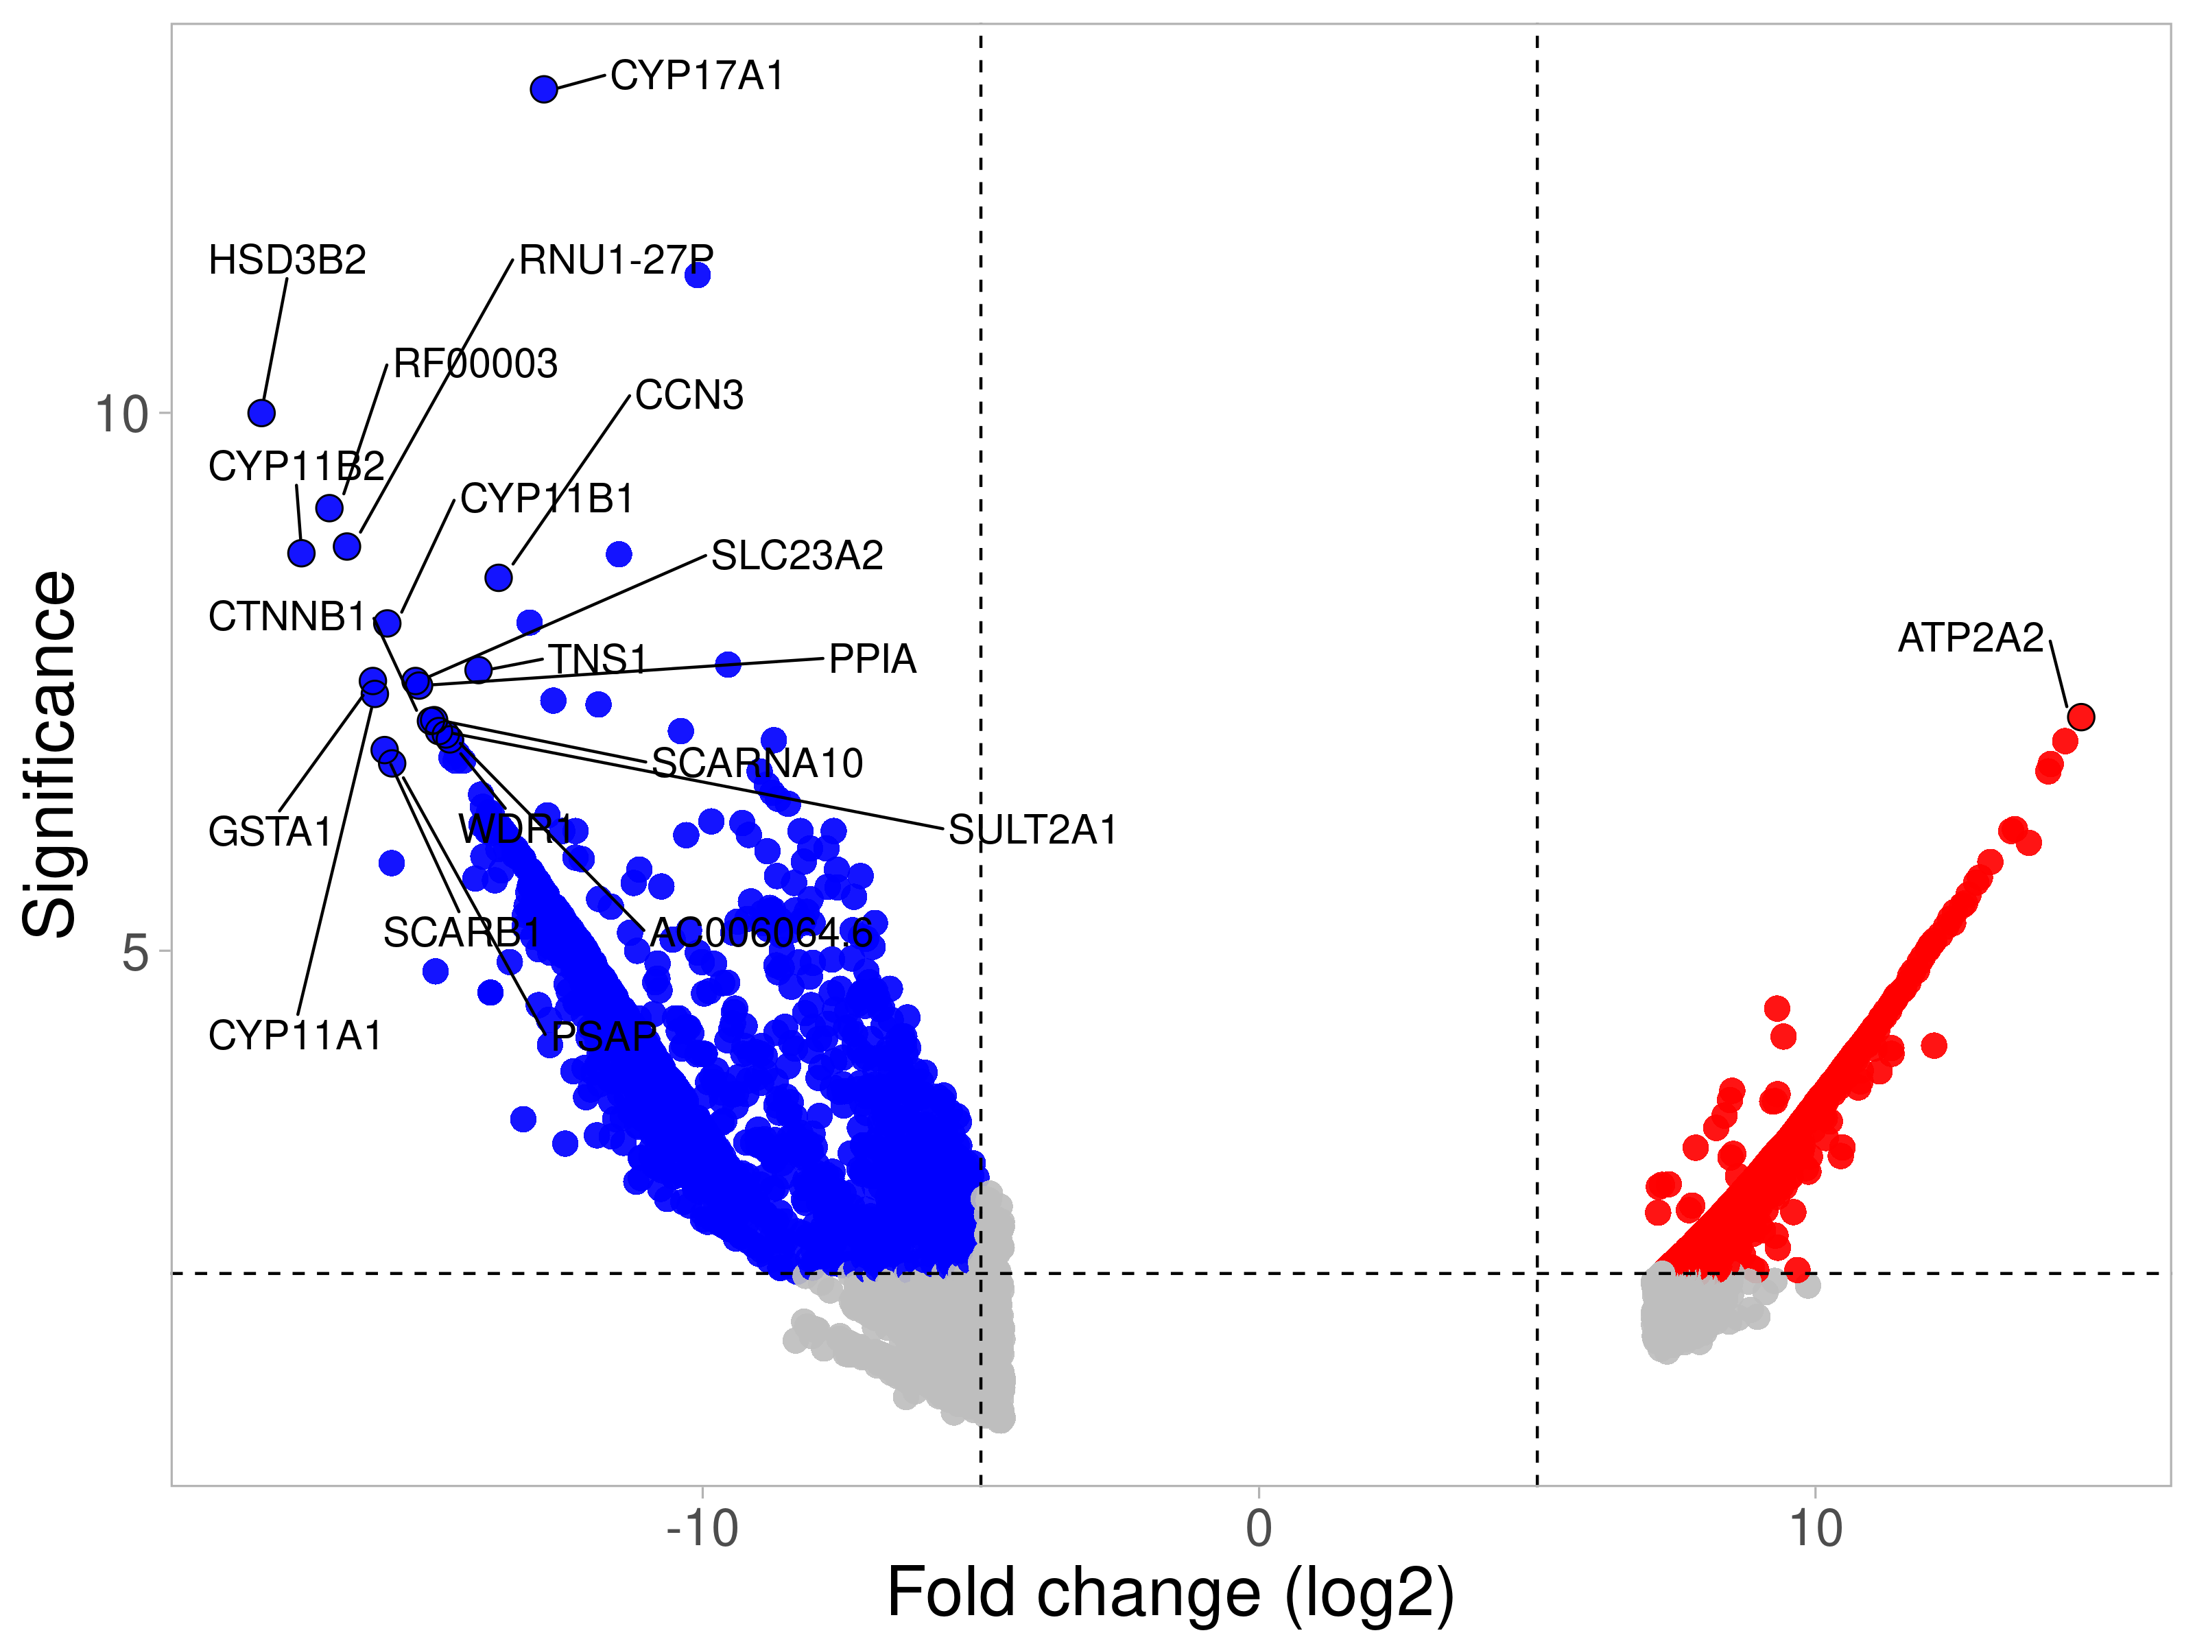
A)
WT hiPSC-CMs
HCM hiPSC-CMs
B)
-log10 p-value)
-log10 p-value)
Fold change (log2)
Fold change (log2)
C)
i.
ii.
-log10 p-value)
-log10 p-value)
Fold change (log2)
Fold change (log2)
D)

Slide 4
A)
B)
WT hiPSC-CMs Vs WT hiPSC-CMs-Paced
HCM hiPSC-CMs Vs HCM hiPSC-CMs-Paced
WT hiPSC-CMs Vs HCM hiPSC-CMs
WT hiPSC-CMs Vs WT hiPSC-CMs-Paced
WT hiPSC CM Vs HCM hiPSC CM
WT hiPSC CM Vs WT hiPSC CM Paced
HCM hiPSC CM Vs HCM hiPSC CM Paced
WT hiPSC CM Paced Vs HCM hiPSC CM Paced
C)
D)

Slide 5
A)
B)
C)
D)

Slide 6
a
b
GO Biological Process​ | Fold Enrichment (of 127 genes)​ | P-value (Bonferroni correction)​
DNA integration​ | 58.34​ | 1.88E-06​
RNA-dependent DNA biosynthetic process​ | 33.33​ | 3.95E-06​
DNA biosynthesticprocess​ | 10.81​ | 1.15E-02​
RNA phosphodiester bond hydrolysis, endonucleolytic​ | 12.07​ | 2.74E-02​
RNA phosphodiester bond hydrolysis ​ | 9.20​ | 2.14E-03​
Supplementary Figure 1a and 1b. (a) Phenotypic analysis of HCM hiPSC-CMs compared to their isogenic WT hiPSC-CM control. (b) Transcriptomic analysis of hiPSC-CMs. A) The GO biological processes regulated by the presence of the HCM disease mutation.

Slide 7
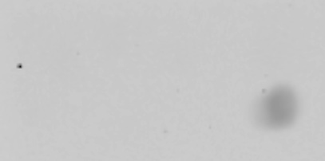
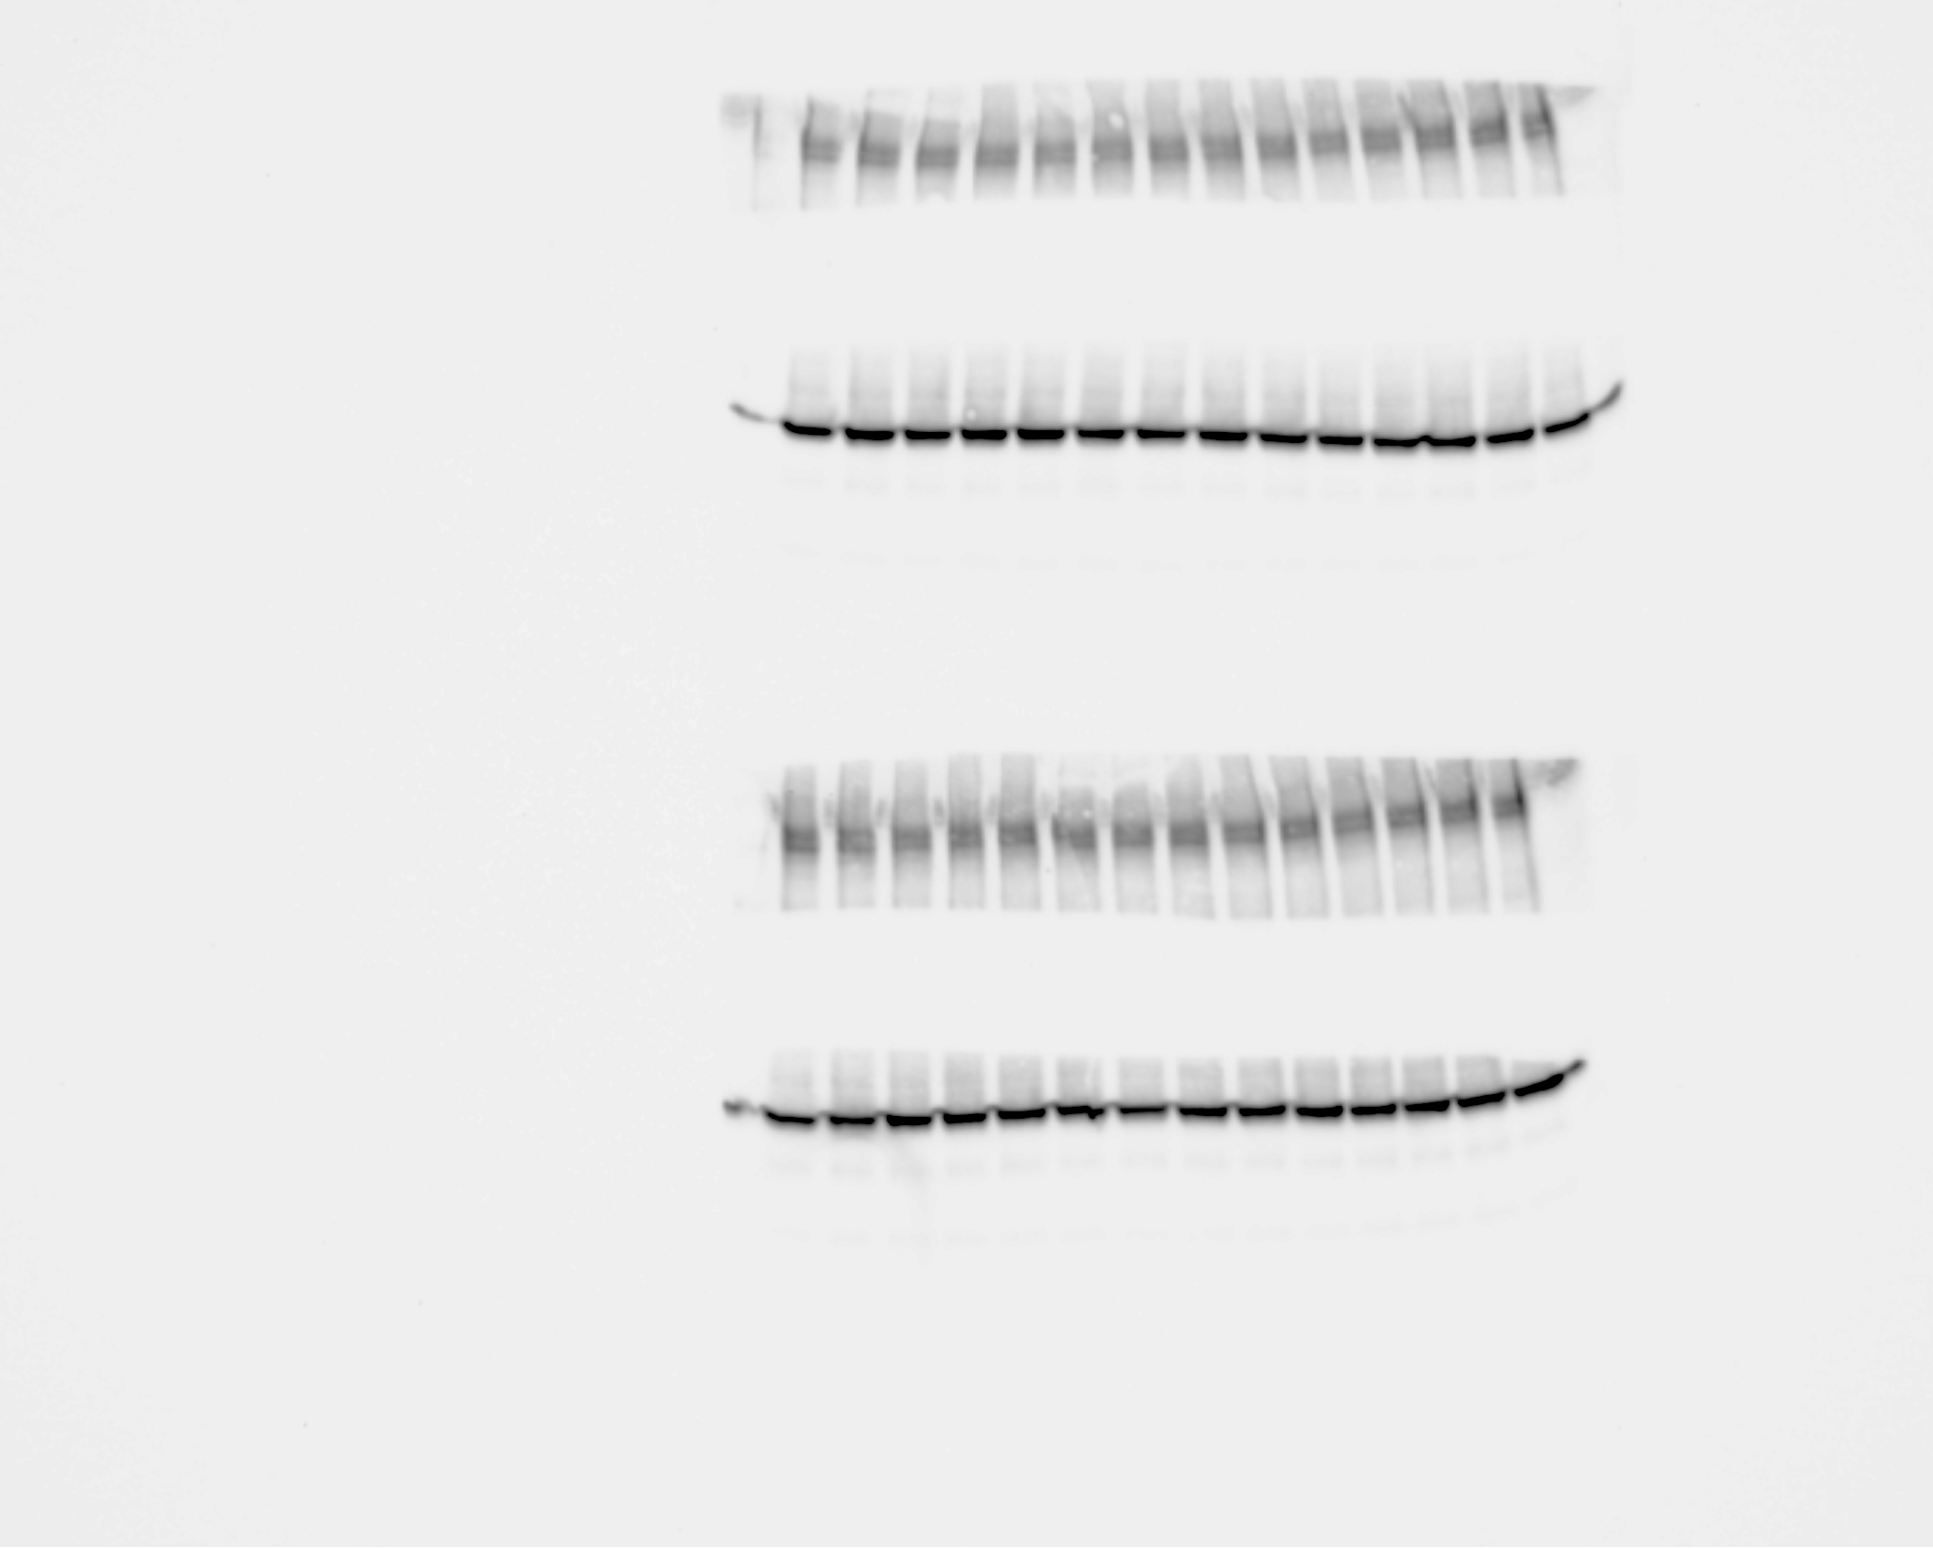
A)
B)
WT hiPSC CM EV
HCM WT hiPSC CM EV
Paced
Total cell lysate
+ - + - -
+ - + -
- + + -
- - - - +
HCM WT hiPSC CM EV
WT hiPSC CM EV
Anti-GM130
250
Anti-Alix
100
Anti-CD9
25
20
C)

