Slide 1
Instant Data
Instant Data
Finding and Cataloguing Externally Hosted Research Datasets Through Automation
Finding and Cataloguing Externally Hosted Research Datasets Through Automation
Dr Jonathan Green and Julie Baldwin
University of Nottingham Libraries
Dr Jonathan Green and Julie Baldwin
University of Nottingham Libraries

Slide 2
Why a data catalogue?
Multiple policies on sharing research data - Increasingly, these are focusing on ensuring this data is shared FAIR-ly
Within our Research Data Management policy we ask for deposit and where possible, sharing of research data in the most appropriate archive
This is often not our own institutional repository
However, the result of this is a lack of visibility of our researchers' datasets
Enable us to discover and track externally created datasets
Enhance visibility and connectivity of these datasets through linked metadata records
Useful tool to gauge institutional policy compliance
Solution = to create a catalogue of externally deposited datasets within our data repository

Slide 3
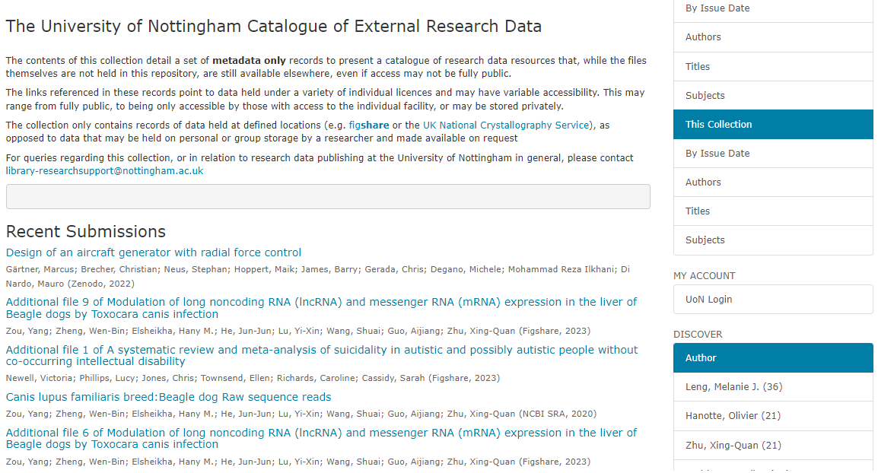
Data catalogue – Home page

Slide 4
Data catalogue – Metadata record

Slide 5
Initial method
Based on code shared by Durham/Manchester to utilise the Scholix online service as a data source
Multi-stage process consisting of the following steps:
Manually extract data from the Research Information System
Manually run data through several perl and python scripts
Manually review results for data quality
Manually convert data to fit an import spreadsheet template
Automatically convert spreadsheet to SAF
Import to Dspace
Some problems with this approach...

Slide 6
Revised method
Any Datasets for this DOI?
Any recent publications with DOI's?
Scholix API
Sure! DOI's, Authors, etc
Dspace
Server
Sure! 10.123... etc
Research Information
System API
Any licence for this DOI?
Extraction Process
Sure! That's CC-BY
Datacite API
Dspace
Research Support Team
Library SystemsTeam
Import Process

Slide 7
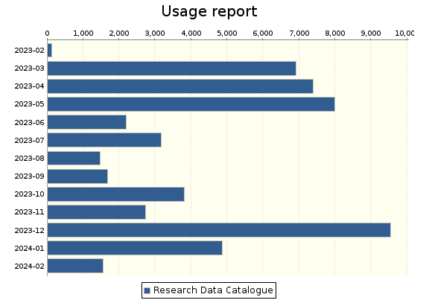
Impact so far
In numbers:
Number of records – Initial import 384 – Current total 458
Usage – total item views 53,232
Resourcing: Initial plan was to be a low-profile project with minimal staff resourcing due to ability for automation.18 months on – this is still the case.
Need for keeping it a small-scale operation impacts the ability to grow the catalogue e.g. communications campaign.
BUT profile of research data within institution seems to be growing - especially data as an intuitional asset, so we may be ahead of the curve if approached by senior stakeholders.

Slide 8
Reflections and discoveries
Definitions of 'data' - what to include, what to discount
Automation only takes you so far, still needs time investment by a human
Versioning of DOIs
Non-standard metadata:
Multiple DOIs of the same dataset – relying on users own record creation
Some edge cases required manual editing (before and after import)
Hundred of creators on a dataset
There are lots of data untapped data sources!

Slide 9
Next Steps
Add a manual (Dspace UI based) workflow for ad-hoc deposits
UI tweaks to metadata presentation
Potentially auto-deposit straight to workflow for review
Migration to Dspace 8 and code cleanup
Potentially expand scope to include non-linked datasets
Consider implementing policy that all externally hosted datasets should be entered into the catalogue
Manual Deposit
Review Step
Live Record
Auto-Deposit

Slide 10
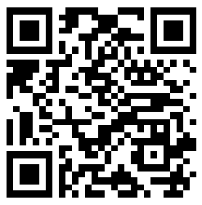
Contact:
julie.baldwin@nottingham.ac.uk
jonathan.green@nottingham.ac.uk
Data Catalogue:
https://rdmc.nottingham.ac.uk/handle/internal/10055

