Slide 1
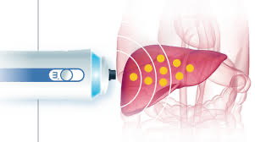
Patients & Setting
Non-invasive markers of liver fibrosis for monitoring of long-term methotrexate therapy: A multi-centre longitudinal cohort study
Non-invasive markers
Results
Exposed
vs
Unexposed
Liver stiffness
4.9 kPa (P = 0.049) 5.3 kPa
≥ 11.5 kPa
5.5% (P = 0.01) 11.6%
2014 - 2021
RA or Psoriasis (n=999)
Exposed to MTX (n=876)
Unexposed to MTX (n=123)
Enhanced liver fibrosis score (ELF)
9.32 (NS) 9.28
≥ 11.3
2.9% (NS) 2.9%
Cumulative
4.8 g
6 years
Neither MTX cumulative dose nor duration was associated with elevated liver stiffness
Type 2 diabetes and BMI were significantly associated with elevated liver stiffness
E Atallah, JI Grove, et al (2023)

