Slide 1
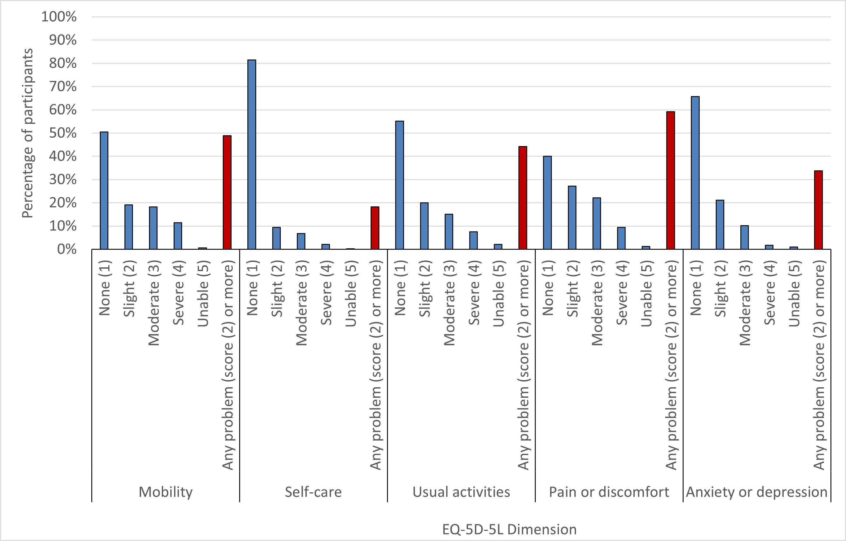
Notes:
Figure 1. Distribution of the percentage of participants reporting problems within the five dimensions of EQ-5D-5L

Slide 2
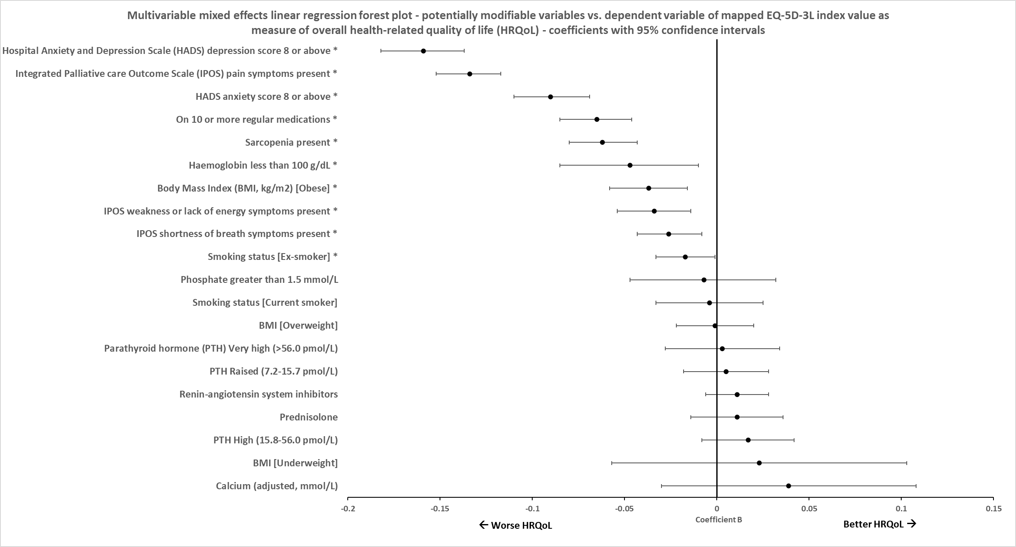
Notes:
Figure 2. Forest plot of associations with mapped EQ-5D-3L index values in mixed effects multivariable linear regression

Slide 3
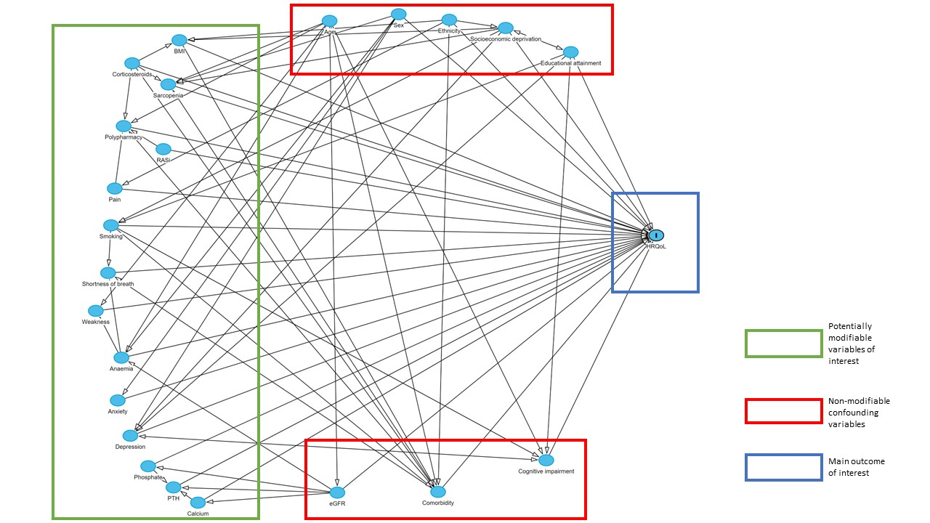
Notes:
Figure S1. Direct acyclic graph (DAG) model of interaction between available variables to aid decision-making in adjustment of models and covariate selection

