Slide 1
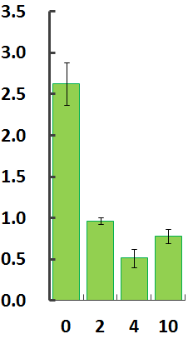
Supplementary figure 1
Endogenous ATP per animal (pmol)
Antimycin A (µM)

Slide 2

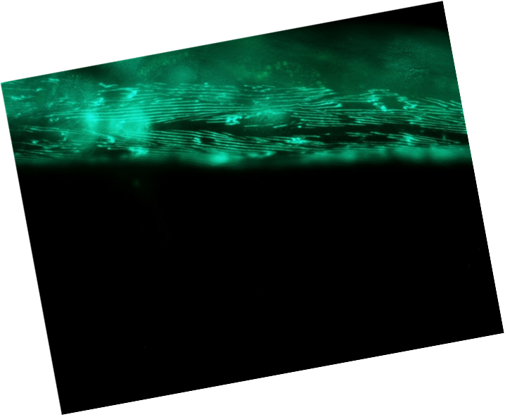
Supplementary figure 2
4D
Cont.
4D
emb-9 RNAi

Slide 3
Supplementary figure 3
A
+ MMP inh.
B
+ Furin inh.
a
a
a
a
a
a
a
a
EMB-9::mCherry (%)
EMB-9::mCherry (%)
C 2 4 10
C 2 4 10
Antimycin A (µM)
Antimycin A (µM)
C
+ unc-68 RNAi
a
a
a
a
EMB-9::mCherry (%)
C 2 4 10
Antimycin A (µM)

Slide 4

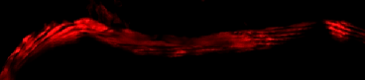
Supplementary figure 4
Control
+ 10 µM Rotenone

Slide 5
Supplementary figure 5
A
B
OCR (pmol/min/worm)
OCR (pmol/min/worm)
0 2 4 10
0 2 4 10
Antimycin A (µM)
Rotenone (µM)

Slide 6
Supplementary table 1
Protein | Function | Human ortholog | Peptide Sequence* | 4 µM AA treatment / control | 10 µM AA treatment / control
LET-2 | type IV collagen | COL4A | lWDGYSLLYIEGNEK | 0.728 | 0.731
COL-19 | cuticle collagen | SFTPD | QAGFEQCNCGPK | 0.445 | 0.649
COL-119 | cuticle collagen | SFTPD | DGAQGGPGEK | 1.047 | 0.738
VHA-13 | vacuolar H ATPase | ATP6V1A | 16 peptides** | 1.019 | 1.057
* Each specific peptide was used for LC-MS / MS quantitative analysis.
** ALEEFYEK, DIADITQSIYIPK, DSMGDLIYQLSAMK, DYEDLAEAMANAFR, EASIYTGITLAEYFR, FKDPVADGEAK, FSMLQIWPVR, HAVEATAQSDNK, KDYEDLAEAMANAFR, LAANNPLLCGQR, LASFYER, NYPEFVSLR, TALVANTSNMPVAAR, TGKPLSVELGPGIMGSIFDGIQRPLK, TVISQSLSK, and VGHQELVGEIIR were used.

