Slide 1
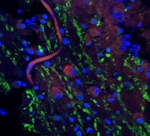
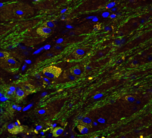
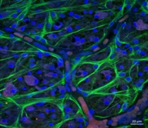
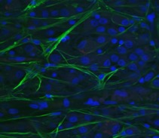
Supplementary figure 1
TUBB
GFAP
IBA-1
AD
Control
AD
Control
AD
Control
A
C
D
E
F
B
4
VA12-38I
20 μm
2012-193I
20 μm
VA12-64T
20 μm
2015-0471T
20 μm
18-41I
20 μm
2016-00245I
20 μm
A1
A2
B1
B2
C1
C2
D1
D2
E1
E2
F1
F2
NFL
20 μm
GCL
20 μm
NFL
20 μm
GCL
20 μm
NFL
20 μm
GCL
20 μm
NFL
20 μm
GCL
20 μm
NFL
20 μm
GCL
20 μm
NFL
20 μm
GCL
20 μm
A3
A4
B3
B4
C3
C4
D3
D4
E3
E4
F3
F4
IPL
20 μm
INL
20 μm
IPL
20 μm
INL
20 μm
IPL
20 μm
INL
20 μm
IPL
20 μm
INL
20 μm
IPL
20 μm
INL
20 μm
IPL
20 μm
INL
20 μm
Supplementary Fig 1: Confocal images of wholemount retina with depth profiles. A-B: Representative TUBB immuno
labelling shown for an AD (A) and a control (B) eye. A1-A4 and B1-B4: Z-stacks were taken and the labeling in the NFL,
GCL, IPL and INL layers are shown. C-D: Representative GFAP immunolabelling shown for an AD (C) and a control (D) eye.
C1-C4 and D1-D4: Z-stacks were taken and the GFAP labeling in the NFL, GCL, IPL and INL layers are shown. E-F: Representative IBA-1 immunolabelling shown for an AD (C) and a control (D) eye. E1-E4 and F1-F4: Z-stacks were taken and the Iba-1 labeling in the NFL, GCL, IPL and INL layers are shown.

Slide 2
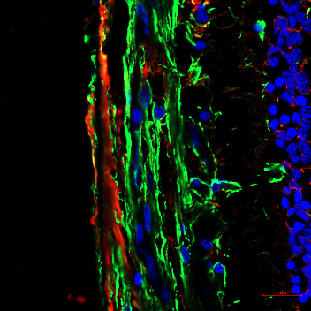
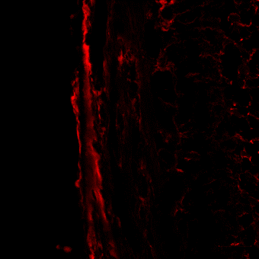
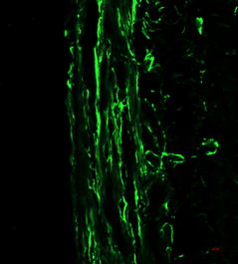
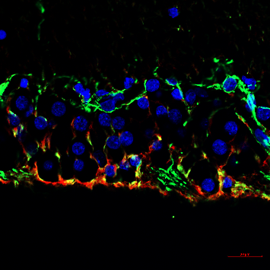
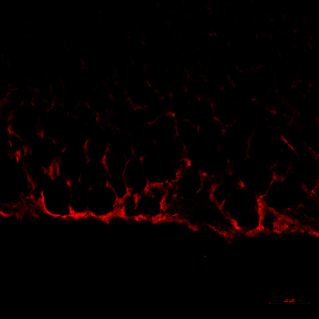
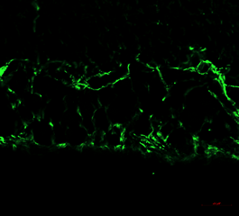
Supplementary figure 2
A
B
C
AD
GCL
IPL
20μm
20μm
20μm
INL
D
E
F
Control
GCL
IPL
20μm
20μm
20μm
INL
GS and GFAP
GS
GFAP
Supplementary Fig 2: Additional examples of GS and GFAP double-labelling at higher power.
Notes:
40x image
AD: VA15-37-C
Control: 2007-347-C

Slide 3
Supplementary figure 3
Activated + Resting
Muller
Astrocytes + Activated
Muller
Activated Muller
Resting Muller
Astrocytes
AD
20 μm
20 μm
20 μm
20 μm
20 μm
20 μm
Original
All GS
(Red Channel)
All GFAP
(Green Channel)
Double labeled
(Yellow Only)
GS Only
(All GS – GFAP)
GFAP Only
(All GFAP – GS)
Activated + Resting
Muller
Astrocytes + Activated
Muller
Activated Muller
Resting Muller
Astrocytes
Control
20 μm
20 μm
20 μm
20 μm
20 μm
20 μm
Original
All GS
(Red Channel)
All GFAP
(Green Channel)
Double labeled
(Yellow Only)
GS Only
(All GS – GFAP)
GFAP Only
(All GFAP – GS)
Supplementary Fig 3: Quantitative masking and subtraction methods used to identify the labelling associated with resting Muller cells, activated Muller cells and astrocytes in retina.

Slide 4
Supplementary figure 4
IBA-1 and BA4 double staining
IBA-1 BA4 DAPI
AD
Control
A
B
10 μm
10 μm
Supplementary Fig 4: Illustration of double labeled amyloid beta deposits (arrows) in the AD and control samples. Green labelling represents IBA-1. Red labelling represents BA4. Blue labelling represents DAPI.

